Slide 1
MTRN2500
Tutorial 8 – Class Relations & Webots II

Slide 2
Class Relations
Notes:
Note: this covers the basics of practical class usage. Students should still refer to the lecture for additional concepts of classes

Slide 3
Object Relationships
There are multiple ways that two classes may be related:
Inheritance – “is-a” relationship
A Drone is-a vehicle
Association – “has-a” or “uses-a” relationship
A drone has-a pilot
A drone has-a propellor
Composition – “exclusive has-a” relations (child is part of parent and only belongs to one parent)
A drone has-a propellor and this is exclusively owned by the drone
Aggregation – “non-exclusive has-a” relationship
A drone has-a pilot and the existence of the pilot is not managed by the drone
Notes:
https://www.visual-paradigm.com/guide/uml-unified-modeling-language/uml-aggregation-vs-composition/

Slide 4
What is Polymorphism?

Slide 5
Polymorphism
Polymorphism is a means of working with different objects in a uniform way
Polymorphism describes the concept that you can access objects of different types through the same interface
Polymorphism is the ability of an object to take on many forms
…
Notes:
Using virtual functions and run-time polymorphism does incur some run-time cost (time and memory)
- This can be significant at times
- Avoid overuse of virtual functions
https://stackify.com/oop-concept-polymorphism/

Slide 6
Polymorphism
Compile-time
Run-Time
Function Overloading
Operator Overloading
Function Overriding
Virtual Function
Notes:
https://www.geeksforgeeks.org/cpp-polymorphism/

Slide 7
Virtual Functions
Virtual functions (virtual keyword) are those that are defined in a base class and are meant to be overridden in the derived class
Virtual functions implemented in the base class are then overridden (override keyword) in child classes
Virtual functions ensure that the derived classes function implementation is always called
The most-derived version of the function that exists between the base class and the derived class will be called
If a class is up-casted, the derived implementation is still called
This is known as dynamic binding
Functions whether the override keyword is included in the child class or not

Slide 8
Code Example
class A {
public:
virtual std::string getName() const { return "A"; }
};
class B: public A {
public:
virtual std::string getName() const { return "B"; }
};
class C: public B {
public:
// note: no getName() function here
};
class D: public C {
public:
virtual std::string getName() const { return "D"; }
};
// Ex 1
B b{};
A& rBase{b};
std::cout << rBase.getName(); // “B”
// Ex 2
D d{};
A& rBase{d};
std::cout << rBase.getName(); // “D”
// Ex 3
C c{};
A& rBase{c};
std::cout << rBase.getName(); // “B”
Notes:
Use the ‘virtual’ keyword in the base class and the ‘override’ specifier (without virtual) in the child classes

Slide 9
Code Example
class Robot {
public:
virtual void move() {
std::cout << "Robot is moving\n";
}
};
class WheeledRobot: public Robot {
public:
void move() override {
std::cout << "Wheeled robot is driving\n";
}
};
class FlyingRobot: public Robot {
public:
void move() override {
std::cout << "Flying robot is soaring\n";
}
};
WheeledRobot wheeled{};
FlyingRobot flying{};
std::vector<Robot*> robots {&wheeled, &flying};
for(const auto& elem : robots) {
elem->move();
}
// Wheeled robot is driving
// Flying robot is soaring
Notes:
Use the ‘virtual’ keyword in the base class and the ‘override’ specifier (without virtual) in the child classes

Slide 10
Virtual Destructors
Virtual destructors work similar to virtual functions ensuring that the appropriate destructor is called
Makes sure if a base class pointer exists (referring to a derived class instance as previously seen), still calls the child class destructor
Helps prevent memory leaks in programs
If a class is to be inherited, the destructor should be made virtual
class Base {
public:
virtual ~Base() { // note: virtual
}
};

Slide 11
Pure Virtual Functions
Pure virtual functions are not provided a definition
It indicates that a child class must override and implement the given function
Including a pure virtual function makes a class abstract
This means the class cannot be instantiated
Pointers and references can still be used (like in polymorphism previously)
class Base {
public:
virtual void mustImplement() const = 0; // pure virtual function
};
Notes:
https://www.geeksforgeeks.org/pure-virtual-functions-and-abstract-classes/

Slide 12
Webots II

Slide 13
Webots sensor class
Webots utilise a common sensor interface
Sensors are enabled and read the same way; however the return types and additional functions may differ for specific sensors.
class Compass : public Device {
virtual void enable(int samplingPeriod);
virtual void disable();
int getSamplingPeriod() const;
const double *getValues() const;
int getLookupTableSize() const;
const double *getLookupTable() const;
// ...
}
Notes:
You can find the source code for this online – on github, or on your libs.

Slide 14
Initialising a sensor
To enable a sensor in webots you first define the sensor object as a unique pointer. In your objects constructor you can get the sensor using the get<Sensor_name> standard interface and enable the sensor using enable(<time_step).
#include <webots/Compass.hpp>
class RobotExample: public webots::Robot {
public:
RobotExample::RobotExample() : Robot() , compass{ getCompass("compass")}{
compass->enable(TIME_STEP);
}
private:
std::unique_ptr<webots::Compass> compass{};
}

Slide 15
Reading from a sensor
Most sensors use the common interface "getValues()" to read in sensor data. More complex sensors such as Lidar and Camera use custom interfaces.
//Compass example
const double* compassValues = compass->getValues();
//Get first data
std::cout << compassValues[0] << std::endl;
//Lidar example
const WbLidarPoint* pointCloud = lidar->getPointCloud();
int pointCloudSize pointCloudSize = lidar->getNumberOfPoints();
//Access first point cloud data
Double x = pointCloud[0].x

Slide 16
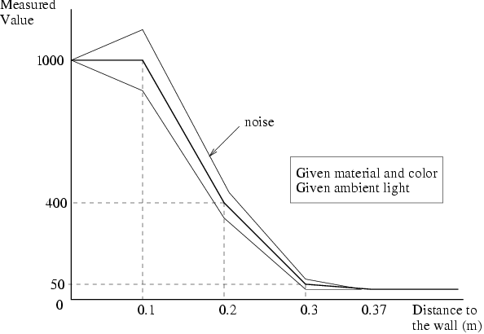
Look up table
Some sensors require a look up table to turn the sensor reading into useable data. This is done to more closely simulate the performance of a real sensor. More information for specific sensors can be found in the webots documentation.

Slide 17
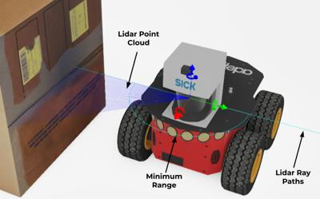
Lidar

Slide 18
Useful sensor documentation
GPS
https://cyberbotics.com/doc/reference/gps
Compass
https://cyberbotics.com/doc/reference/compass
Lidar
https://cyberbotics.com/doc/reference/lidar
Camera
https://cyberbotics.com/doc/reference/camera
Distance sensor
https://cyberbotics.com/doc/reference/distancesensor

Slide 19
Assignment starter sample

Slide 20
Starting on the Assignment
We will go through starting on the assignment and working with the concepts that have been covered in the last couple of weeks
Creating the leader robot controller
Performing the appropriate inheritance
Setting up stub functions as required
Implementing a pure virtual function
Notes:
Work through this task. The final code can be seen in the repository: https://github.com/UNSW-MTRN2500/webots-amcunio
What you need to do:
- Work through to develop the code in the repository
The steps that were taken:
- Create a new robot controller in Webots with the name “LeaderController”
- Assign the new controller to the leader robot within Webots (the central one with the LIDAR on top – Robot “0”)
- Updated Makefile to have the correct additions
- Create a file ‘LeaderController.hpp’ (within the LeaderController directory)
- Setup base class for LeaderRobot that inherits from BaseRobot and includes all the required pure virtual functions
- Added additional pure virtual method to BaseRobot with the following signature `virtual void talk() = 0;`
- Added stub implementations for all functions in LeaderRobot
- Implemented the ‘talk’ function
- Implemented the ‘run’ function (this should contain the main controller logic) that just calls the ‘talk’ function
- Instantiated an instance of LeaderRobot in the controller main and call run
- Demonstrate functionality

Slide 21
Lab tasks

